Slide 1
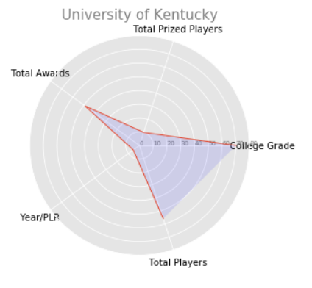
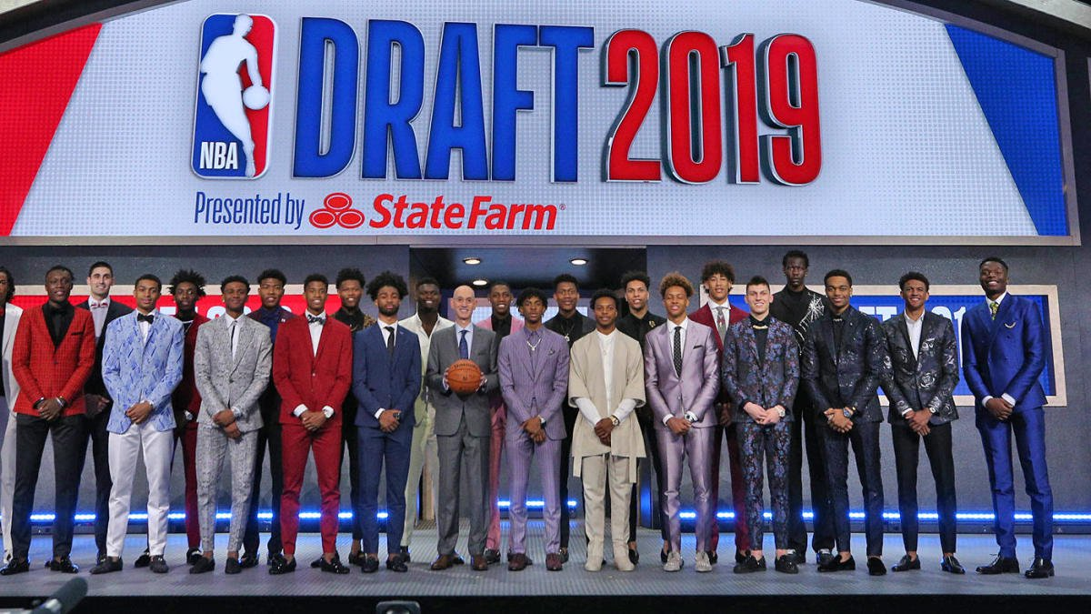
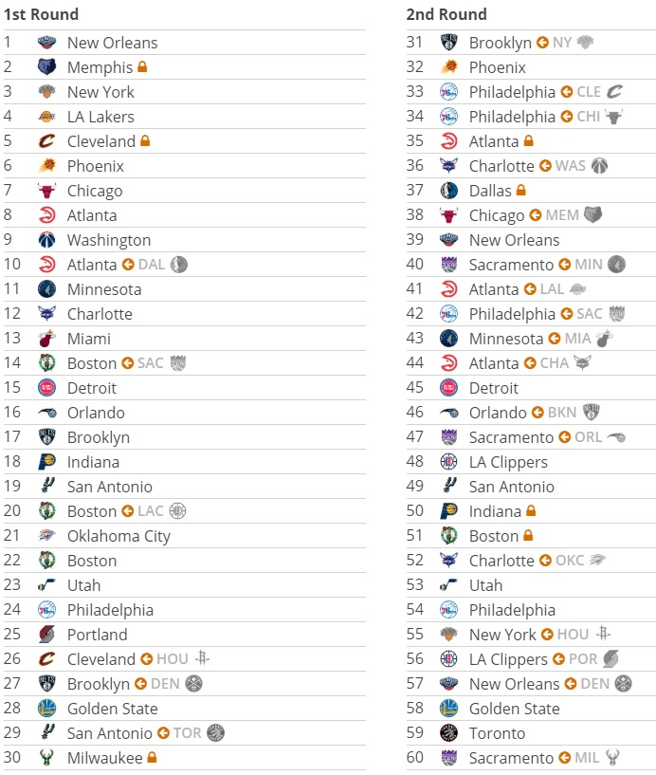
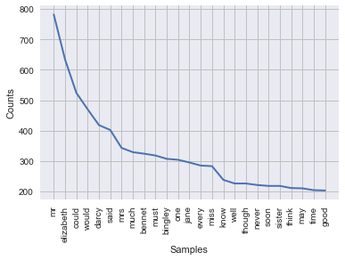
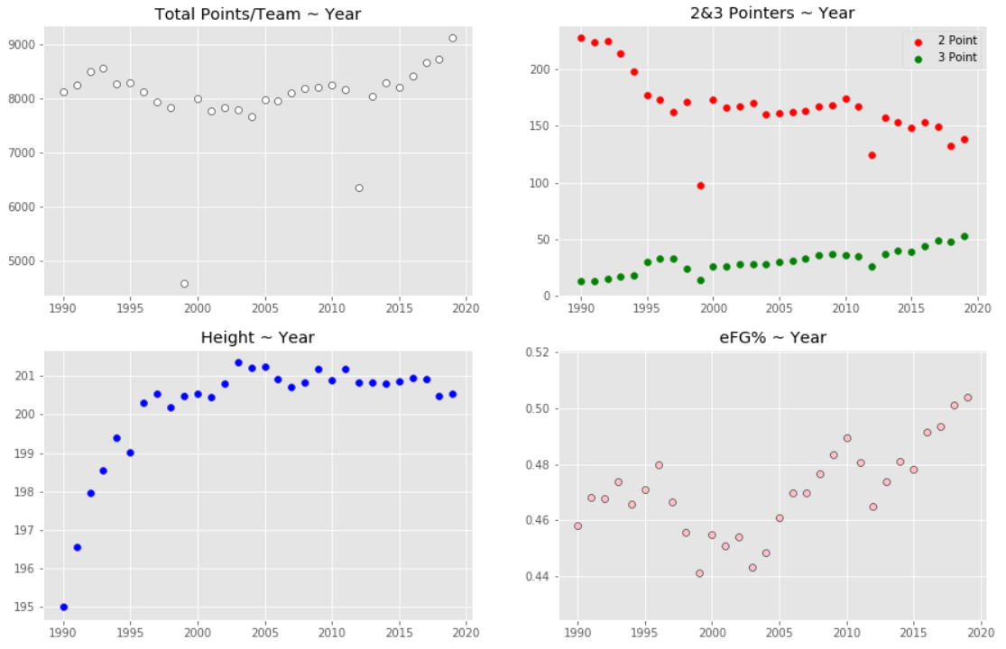
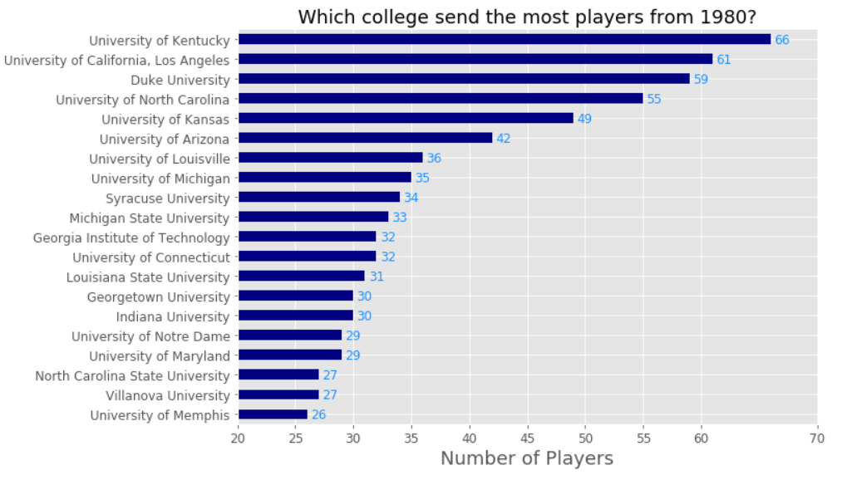
2019 NBA draft – data mining project

Slide 2
students
Moshe Gotam – 303029250
Miki Teplitsky - 315613414

Slide 3
Project Breakdown
Step 1 & 2- Scraping + Scrub
CreateDBup.ipynb
Step 3 - Exploer
ChangedNBA.ipynb
OusideAmerica.ipynb
Step 4 - Model
Clusters.ipynb
Step 5 - Interpret
Scraping from basketball-refernce NBA stats from 1980 season - table for regular season and playoff
Data processing - creating a table of averages and total
Create_NCAA.ipynb
Scraping from realgm NCAA stats from 2003 season
Draft.ipynb
Scraping from basketball-refernce information about the NBA draft from 1989
Data processing - creating a table of averages and total
Examination of the data
Awards.ipynb
Scraping from basketball-refernce NBA individual awards
Checking the progression(?) of the NBA from 1980 to our days
Ploting different subjects -
3PT to 2PT, height, PTS, eFG%
Colleges.ipynb
Top100Prop.ipynb
Scraping from nbaDarft mock draft to get 100 next propects
Merging with data to create table of each player stat
Examing the data
Giving a value to each college by the players succes in the nba
Examing the data - using a formula based on player awards
Scraping a list of countries of players the played in the NBA from Wikipedia
Finding succesful countries with the same formula we used in Colleges.ipynb
High_School_Europe.ipynb
Examing the succes of players that didn't came from a college system
Scaling the data
Clustering the table to 5 groups using K_Means
Examing the the groups - successfully spliting the players to 5 tiers -
Fillers, Role Players, Role Players\All Star, Hall of Fame, Legends
CorrNCAA_NBAGroup.ipynb
Merging the 2 dataset - NBA and NCAA players
Creating the table of players from 2003 - first season
Scaling the stats
Split the dataframe to
X- players stats
Y- player group
Trying to predict using Decision Tree & Naive Bayes
DT grade - 0.34
NB grade - 0.4

Slide 4

First step - scraping

Slide 5

How did we create the database?
Scraping NBA data from basketball-reference
From season 1981
Scraping NCAA data from realgm
From season 2003
Scraping NBA drafts history
From 1989 – first time the 2 rounds format
First step - scraping

Slide 6
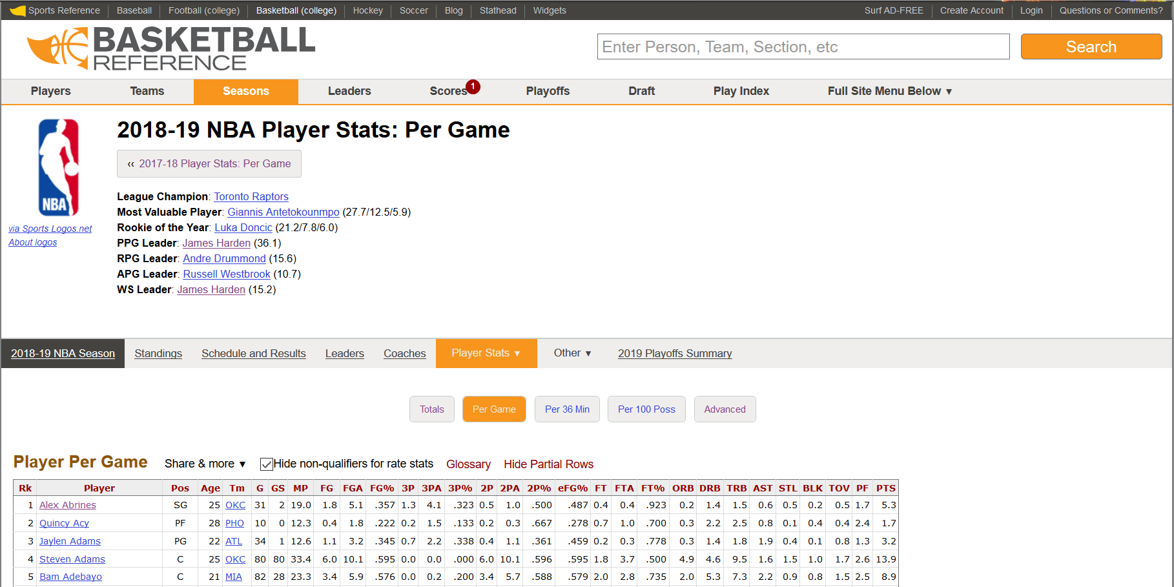
Scraping NBA data from basketball-reference
Scraping using BeautifulSoup
Scraping data for each season and playoff 1981
Total and average
Creating id-key using the link for each player
Creating a table which contains each player career total and average using the scraped data
Creating and additional dataframe, that contains more important data about each player:
Years Played, Height, Width, Position
Merging this dataframe with a calculation of each player personal accolades
First step - scraping

Slide 7
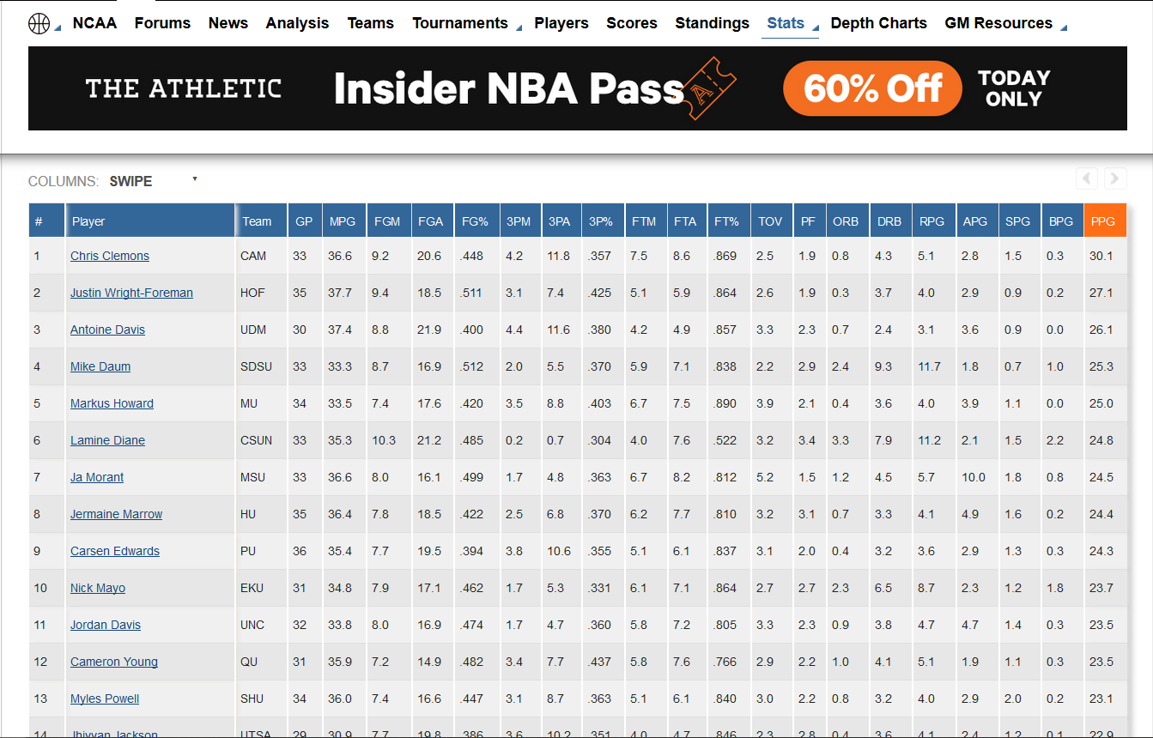
Scraping ncaa data from realgm
Scraping using BeautifulSoup
Scraping the NCAA players from 2003-2019
Creating a table which contains each player total and average using the scraped data.
First step - scraping

Slide 8
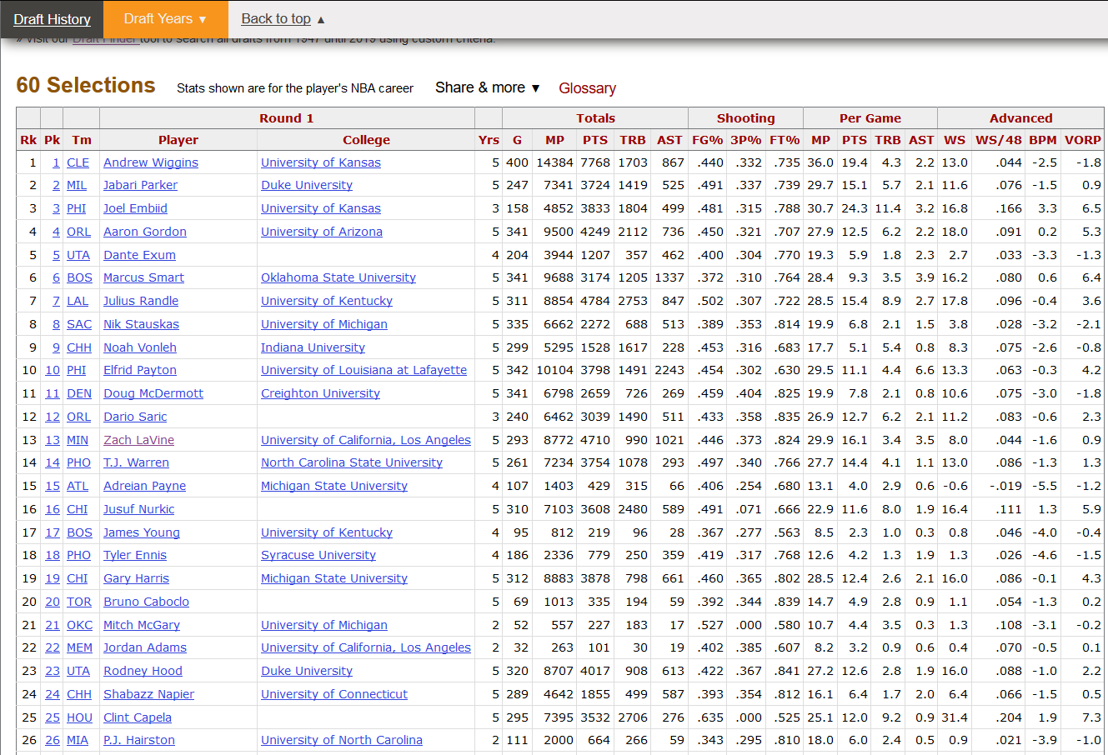
Scraping nba drafts data from basketball-referance
Scarping using BeautifulSoup
Add draft year and draft pick for each player
Merging the dataframe with NCAA stats
First step - scraping

Slide 9
Our database
Data | Number of players | Number of stats | Seasons
NBA Players | 3088 | 25 | 1981-Present
NCAA Players | 15456 | 20 | 2003-Present
NBA Draft | 1742 |  | 1989-Present
First step - scraping

Slide 10

second step - evaluate

Slide 11
Answering a few questions
After scraping the data and getting the information that we need, let’s check a few common questions:
What college has the best system for players?
How’s the international game evolving?
Does the draft pick is based on performance in the college?
second step - evaluate

Slide 12
Best college – the process
To find out which college has the best success in the NBA we will be using 2 csv files - MoreInfoPerPlayer.csv and CareerAVGPlayerScrape.csv
Because some players played in more than one college we will based on the player last college
We will give college a grade based on the number of players, player success, and player longevity
GRADE = ((totalPlayers*Year/Player * 20) + (scale(playerSuccess)) * prizedPlayers) * 80)/100
Giving more value to prizes
playerSuccess = sixth man * 7 + All-NBA *14 + Defence-Team * 6 +All-Star *12 + Defence-Year * 10 + MVP * 20 + Finals-MVP * 22 + MIP * 4 + Rookie * 7
Giving a value to each award grade based on importance
second step - evaluate

Slide 13
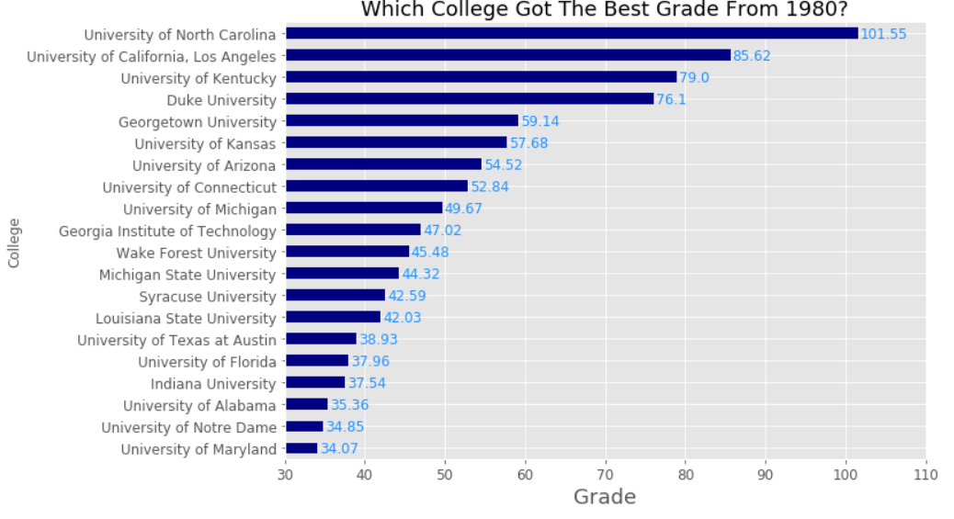
Best college - grades
We can see that “University of North
Carolina” leads by a wide margin (16pts).
We can take a wise guess, without even
checking, that is mostly because Michael
Jordan played in North Carolina in 1980-1982
Because of that we will try to check the same
way but this time we will check based on the players that played in the NBA from 2005.
second step - evaluate

Slide 14
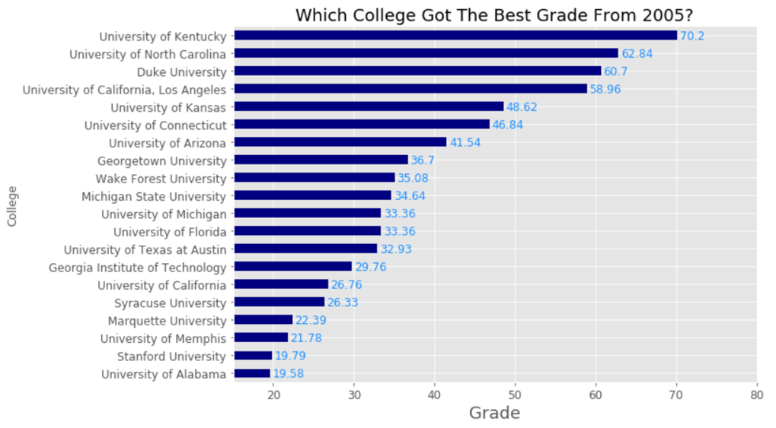
Best college - grades
We can see that “University of North
Carolina” still ranks very high but falls to second place.
“University of Kentucky” ranks first, the college in the last years made famously for “the one and done”, players that play only one year in college, because of the rule from 2005 that draft prospects must be at least 19 years old and a year removed from high school.
second step - evaluate

Slide 15
Outside USA
Basketball may be American-made, but it's increasingly the world's game
Today’s National Basketball Association is much more global than you think, thanks to the league’s impressive growth since 1984.
Between Dallas Mavericks legend Dirk Nowitzki, Milwaukee Bucks star and current MVP Giannis Antetokounmpo, and 3rd pick Luka Doncic, some of the biggest names in the NBA belong to foreign-born players.
In our dataframe there is no nationality column but using
Wikipedia page that contains every international
player we can find!
Dirk Nowitzki
Hakeem Olajuwon
Steve Nash
Gasol Brothers
Tony Parker
second step - evaluate

Slide 16
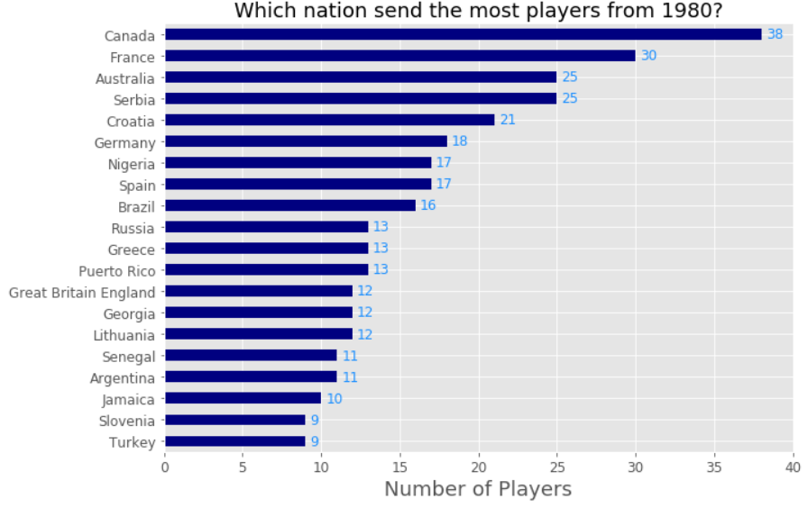
Outside USA – number of players
Canada has produced the most players, with 38.
From European countries, France have produced 30 players, respectively. Among trans-continental countries, Russia and 13 players.
From South American countries, Brazil has produced 16 players.
From African countries, Senegal has produced 11 players and Nigeria has produced 17 players.
Australia has produced 25 players.
China has produced six players.
At least 76 players have come from the former Yugoslavia (Bosnia, Croatia, Montenegro, Serbia, Slovenia, and North Macedonia).
*on our database
second step - evaluate

Slide 17
Outside USA – stats
15.51% of the players in the NBA from 1981 are non-US (497 of 3088)
9.45% of the the non-US players won a personal awards (almost like the US players - 10.11%, 262 of 2591)
6 Awards per USA player (1573), 5 to non-US player (235)
Germany has the highest amount of awards – 35
France has the most prized players - 4
*on our database
second step - evaluate

Slide 18
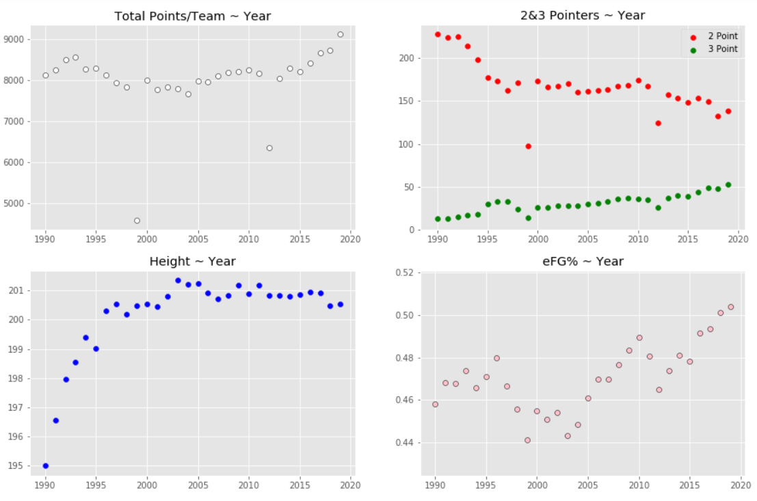
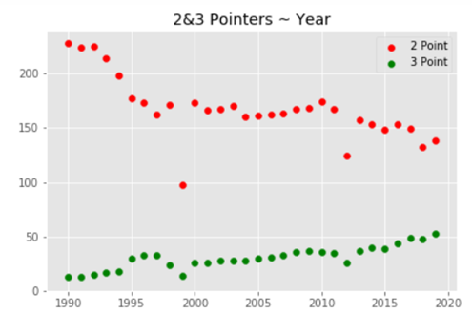
How the game has changed?
second step - evaluate

Slide 19
How the game has changed?
The NBA has evolved over the years and is very much a different game than it was in the showtime Lakers days or even just a decade ago. Despite not a whole lot changing in terms of rules and teams in the past 10 seasons, we have seen a huge shift in the way the game is being played and the results coming from this style of basketball
The advancement of the three-point shot has increased the speed at which the game is being played, this is seen with the increase in quicker possessions
We can easily see that the amount of points scored by team is on the rise from 2003. Which shows that the pace of the game got faster
second step - evaluate

Slide 20
How the game has changed?
It may not be obvious, but the 3-point line continues to change the sport today.
In addition to the players continuing to improve, the utilization of the shot continues to evolve as well. Since the introduction of the 3-point line in the 1980–81 season, 3-point attempts and 3-point percentages have steadily risen while 2-point shots per game have decreased.
second step - evaluate

Slide 21
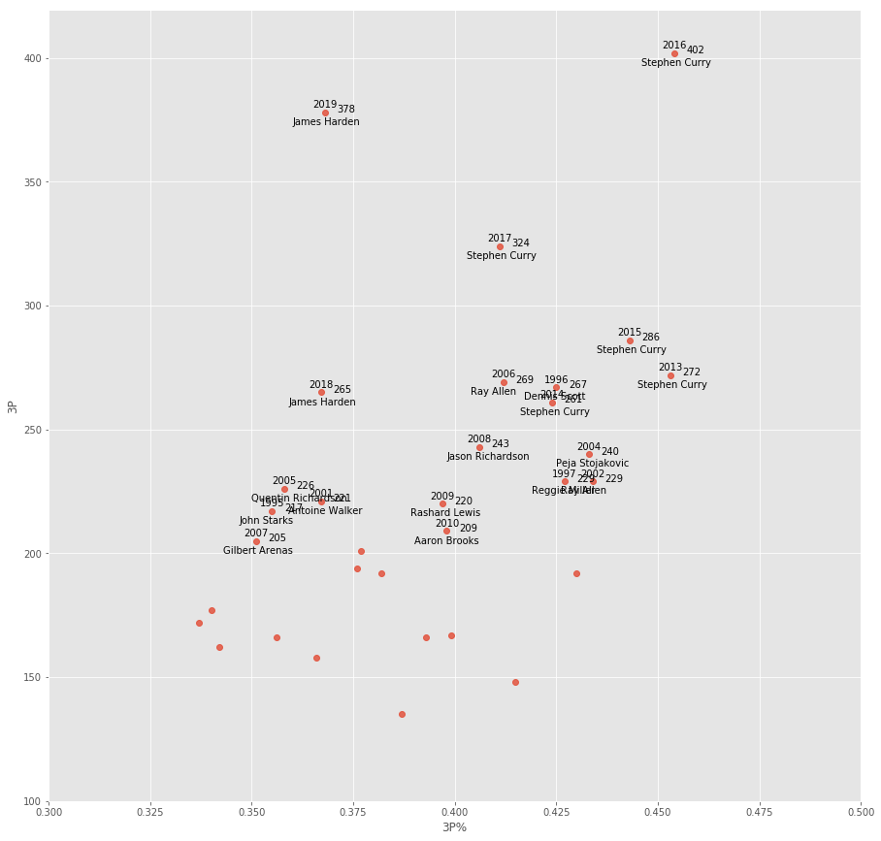

Slide 22
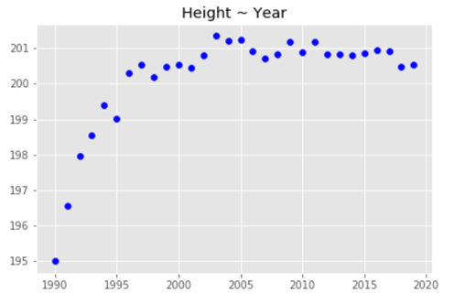
How the game has changed?
Even thought the game speed increased it didn’t affect the height of the players
In matter of fact, the height of the players have increased and we can even see the Center players shot a 3-point shots today
second step - evaluate

Slide 23
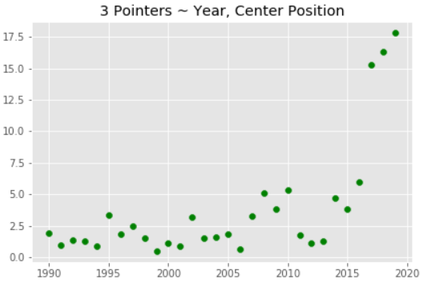
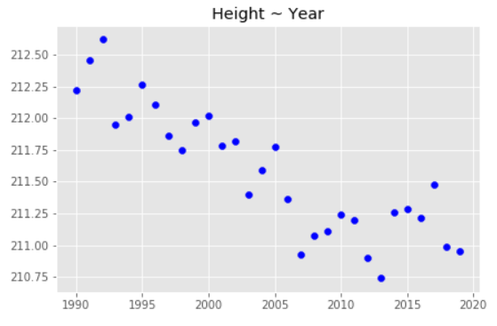
How the game has changed?
Center in the 90s didn’t even shoot 3 but a we can see started in the last 15 years
The center position became more mobile, smaller players that do a lot more
second step - evaluate

Slide 24
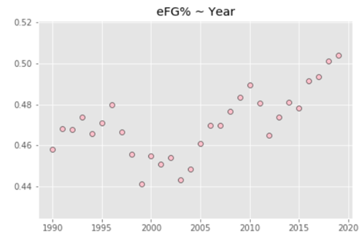
How the game has changed?
We can see that NBA teams are trying their best to have a better efficient field goal percentage
The efficient field goal is increasing steadily each year
second step - evaluate

Slide 25
How the game has changed?
To conclude, the players are higher(in average), have a better “scoring” percentage, faster, and as far as we can see, making the game much more exciting
second step - evaluate

Slide 26
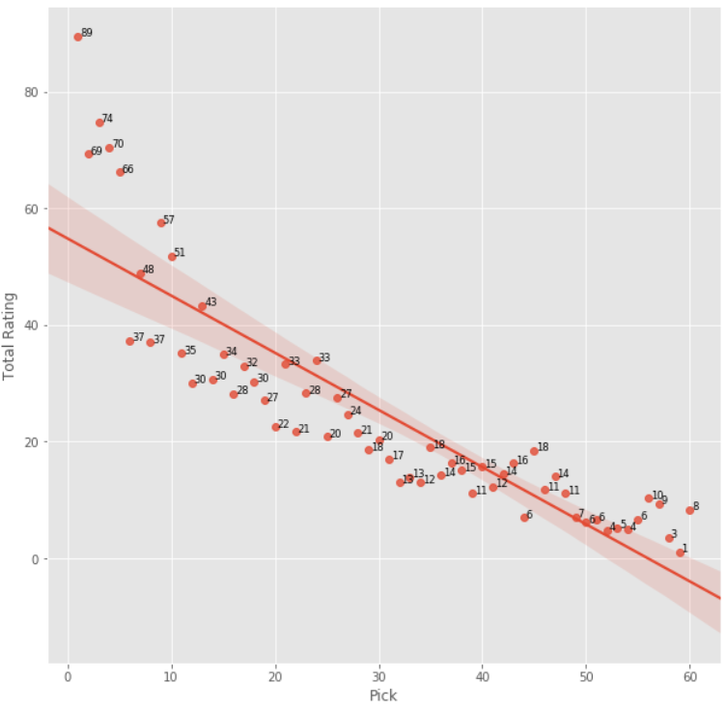
Draft pick ~ performance?
How Basketball Coaches and Recruiters Evaluate Players?
They look a certain parameters
Height/Weight
Athletic ability
Understanding of the game
Plays the game hard
Fundamentals
Potential
Let’s see if we can find a potential in players using the data we have
second step - evaluate

Slide 27
NCAA~ NBA?
We scraped data about 2019 mock draft to find the top 100 draft prospects
We merge the data with the NCAA data
We used a few clustering and supervised learning algorithms to try and predict the tier of the players in the his NBA career
second step - evaluate

Slide 28
Clustering
To help us rank the player we will use K-Means, we will split the players to 5 tiers (clusters)
The X is all the stats of the player, from years in the league to point per game and total awards
After the K-Means we organized the tiers of the players by an ascending order.
second step - evaluate

Slide 29




Clustering - tiers
 | Cluster 0 - Fillers | Cluster 1 – Role Player | Cluster 2 – Role Player – All-Star | Cluster 3 – Hall Of Fame | Cluster 4 - Legend
Number Of Players | 1175 | 1049 | 494 | 62 | 9
Years Played | 2 | 6.09 | 10.8 | 13.64 | 17.66
Freq Position | SG (280) | SF (217) | SG (102) | PG (16) | C (3)
Average Height | 200.9 | 200.38 | 200.6 | 200.57 | 206.86
Awards Per Career | 0 | 0.01 | 1.17 | 15.09 | 42.11
Games | 50.6 | 344 | 753.18 | 906.12 | 149.22
Minutes | 7.9 | 17.85 | 28.16 | 33.58 | 36.66
Points Per Game | 2.44 | 6.33 | 12.46 | 18.37 | 24.27
PIR | 1.5 | 5.35 | 11.2 | 17.72 | 23.54
second step - evaluate

Slide 30
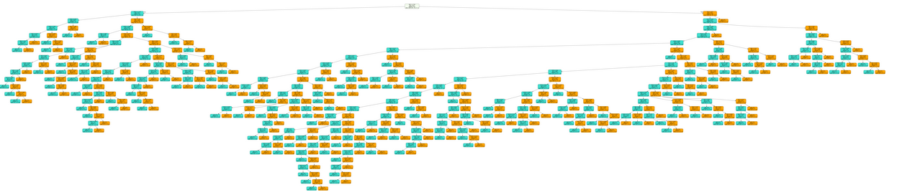
Clustering - Decision tree
To try visually and explicitly represent decisions and decision making we tried to make a decision tree
The decision tree that was generated was too big – too much information(?)
second step - evaluate

Slide 31
Clustering - Naive Bayes
We tried also Naive Bayes methods, our accuracy again was very low
Accuracy on Train data= 0.42934196332254587
Accuracy on test data= 0.40086206896551724
second step - evaluate

Slide 32
Clustering – what can we find?
We can try and find information about each group and find what help the player’s career success
We created a describe to each group with college stats
Group | Draft Pick(mean) | Point Per Game
0 | 51.22 | 12.36
1 | 37.5 | 12.9
2 | 17.44 | 13.89
3 | 17.33 | 14.98
4 | 2 | 25.8
second step - evaluate

Slide 33
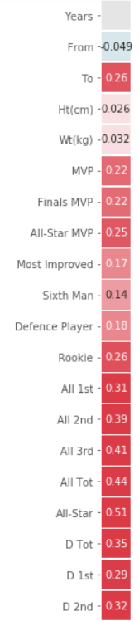
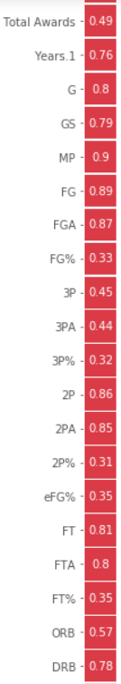
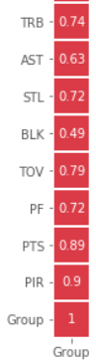
Clustering - Breakdown –Heat map
We gave each cluster a name to make it more easier to understand
0 – Fillers
1 – Role Players
2 – Role Players-All Star
3 – Hall of Fame
4 – Legends
We also changed the number of the group – the higher tier -> higher number, so we can use for correlation
From this heat map we will learn what affects our clustering of the tiers.
second step - evaluate

Slide 34

third step - Interpretation

Slide 35
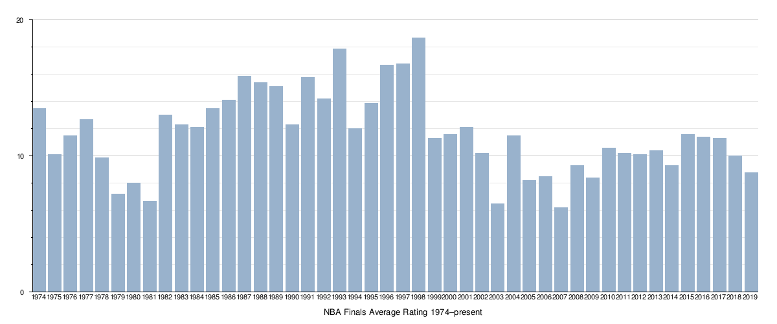
third step - Interpretation

Slide 36
third step - Interpretation
We found what influence the most on player successful career
We can split the players into 5 tiers based on the information on NBA players
The accuracy of the prediction only based on the college stats isn’t working. There are too many “hidden” variables. Some of them we can’t see in analytics such as potential, work rate, etc.
Some more information is available in the web, but you have to pay for it maybe with that you can be more accurate
The NBA is becoming more mobile, more efficient, more widespread, more international – more ratings (?)
We love basketball and it was very interesting to see the league from the analytics view
third step - Interpretation

